Slide 1
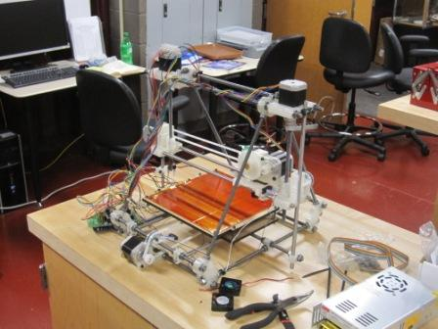
RIP RAP Class at Fab Lab CCBC

